Slide 1
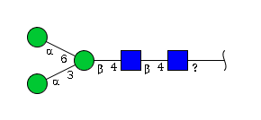
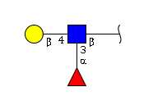
N-Glycan core basic
Lactosamine motif
All other motif sets

